Slide 1

Training and Deploying a ML Model
With Ahad Jawaid

Slide 2
Recap

Slide 3
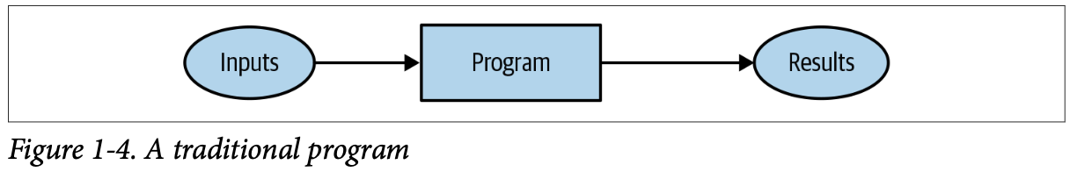
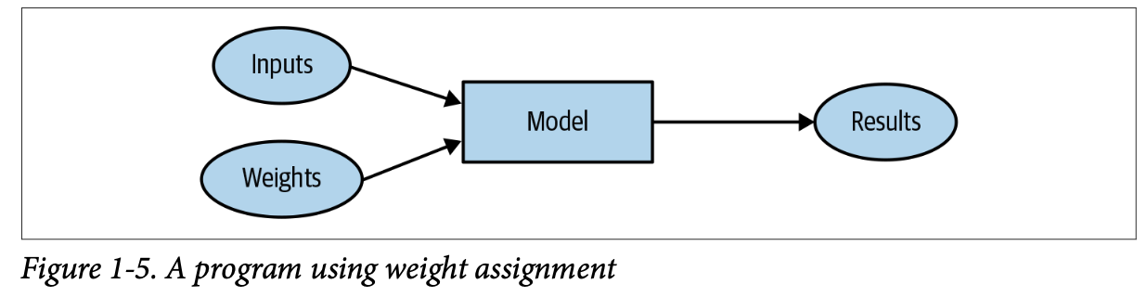
Program vs Machine Learning

Slide 4
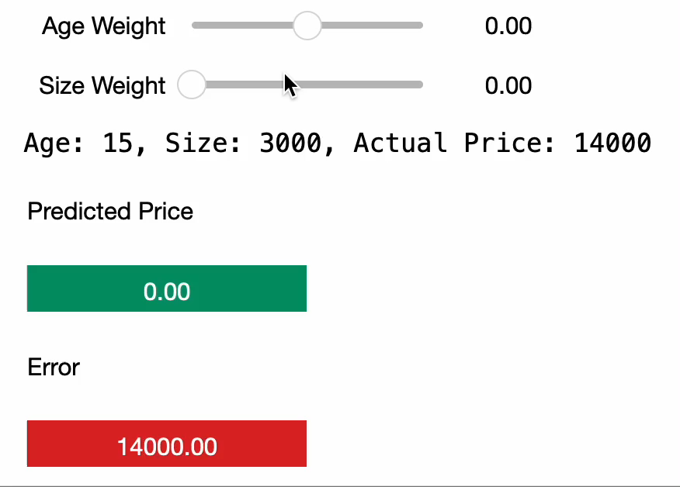
Picking parameters

Slide 5
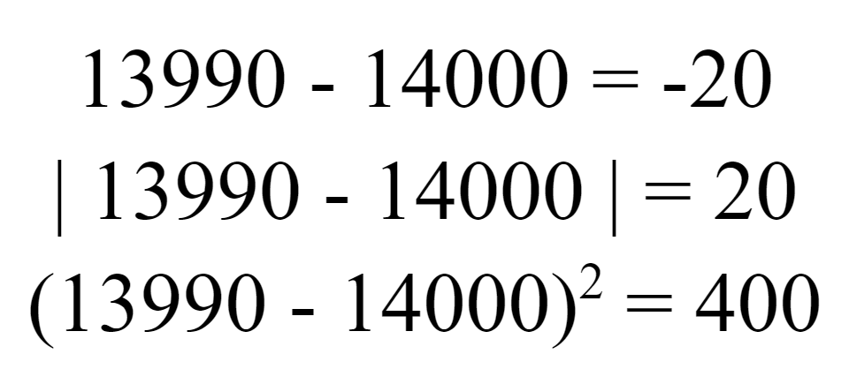
Measurement of Error

Slide 6
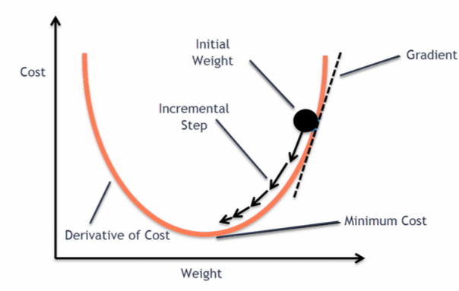
Using slopes to adjust weights
Slope
Error
Error

Slide 7
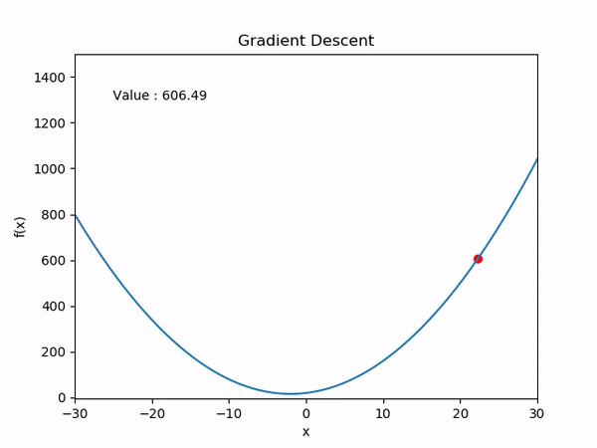
Automating picking parameters

Slide 8
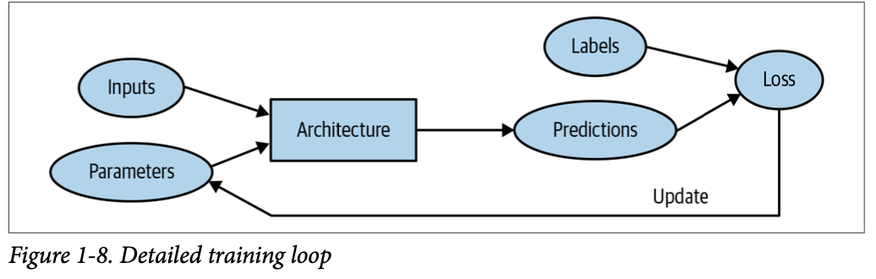
Training a Machine Learning Model

Slide 9
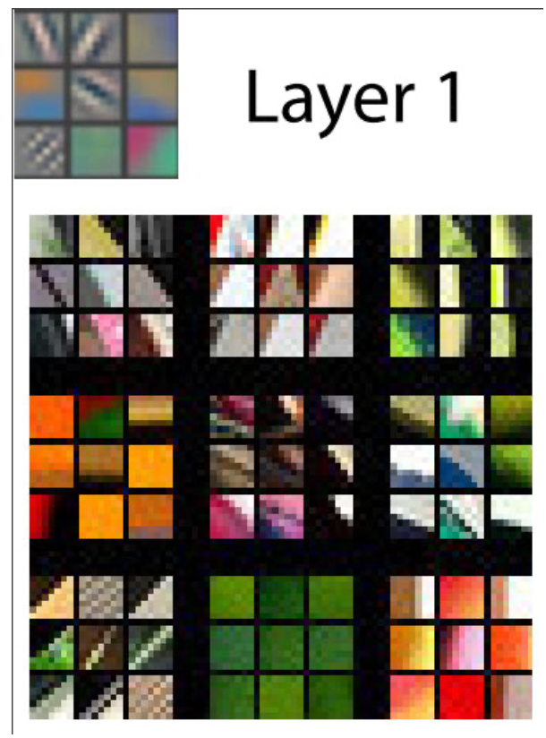
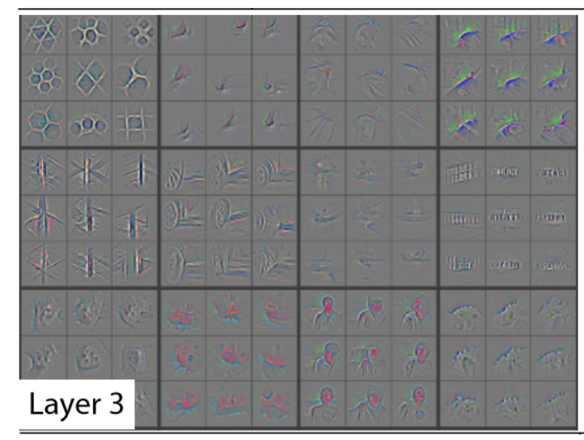
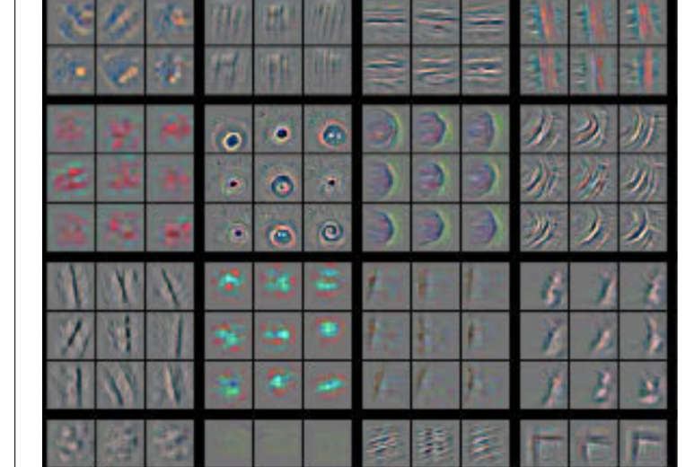
Visualizing Learned Parameters

Slide 10
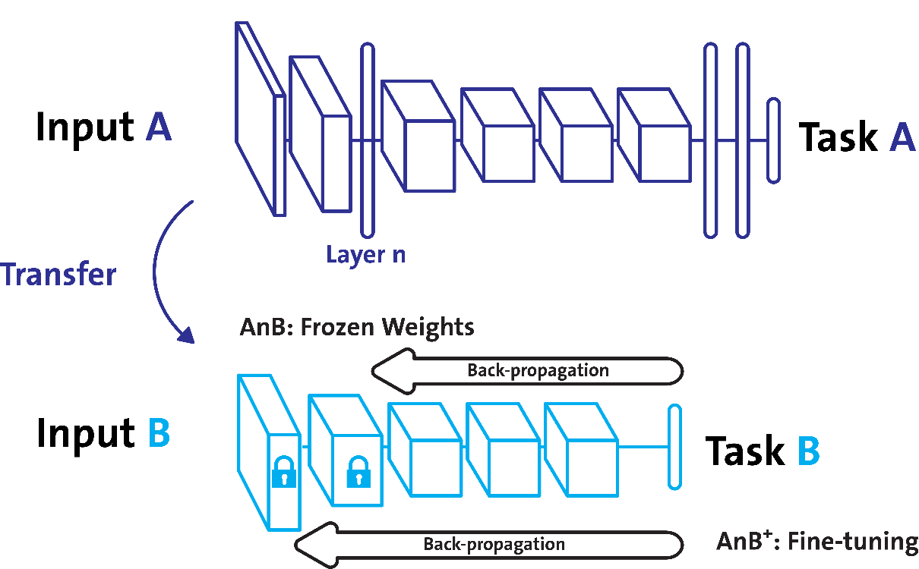
Transfer Learning

Slide 11

Model Capacity

Slide 12


Training / Test Split
Homework (Training Set)
Test
(Validation / Test Set)

Slide 13


Training a Model
Model
You (The trainer)

Slide 14
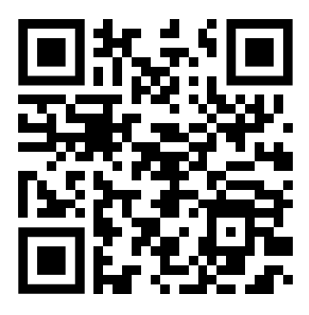
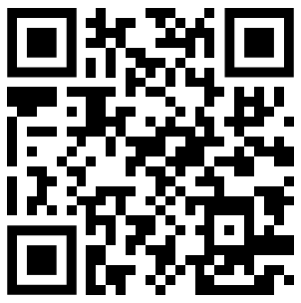
Sign In and Feedback!
Feedback Form
Sign In Form
https://forms.gle/3AmVQFg1tr1KWSNG6
Sign In Code:

